Slide 1
Stock Market Prediction – 8/6/2021 Progress
Kevin Fitzpatrick, Tessa Karlovitz, Dustin Luchmee

Slide 2
Update - Kevin
Captured news headlines, tweets, and OHLC pricing for TSLA, AMD, NVDA, and GE
Ran sentiment analysis on the headlines and tweets using StanfordNLP’s pre-trained sentiment model
Ran 3 machine learning models:
Neural Network
Random Forest
Logistic Regression
Tried to predict if price would be up or down (classification) over the next X number of days (1, 3, 5, 7, and 10 days)

Slide 3
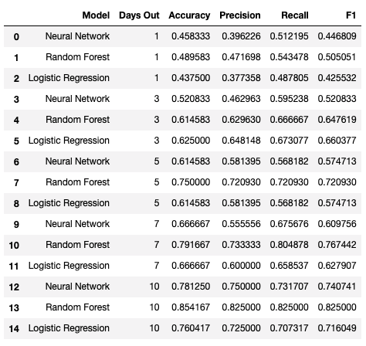
Model Results

Slide 4
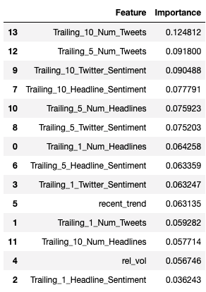
10 Days Out – Feature Importance Ranking For Random Forest

Slide 5
Next Steps
Feature Engineering
Model Tuning

